Slide 1
Chapter 7 Demand Forecasting in a Supply Chain
Supply Chain Management
7-1

Slide 2
Role of Forecasting in a Supply Chain
The basis for all strategic and planning decisions in a supply chain
Used for both push and pull processes
Examples:
Production: scheduling, inventory, aggregate planning
Marketing: sales force allocation, promotions, new production introduction
Finance: plant/equipment investment, budgetary planning
Personnel: workforce planning, hiring, layoffs
All of these decisions are interrelated

Slide 3
Collaborative Forecasting
Historically, SC partners forecast individually
Retailer forecasts demand to choose order quantities
Supplier forecasts retailer order quantities
Often unequal
Move toward collaborative forecasting
Improved accuracy, efficiency, responsiveness
Buzzwords:
CFAR (Collaborative Forecasting And Replenishment)
CPFR (Collaborative Planning, Forecasting, and Replenishment)

Slide 4
Characteristics of Forecasts
Forecasts are always inaccurate
Should include both the forecast and a measure of forecast error
Most firms do not!
Long-term forecasts are usually less accurate than short-term forecasts
Easier to predict tomorrow’s demand than demand on 2/22/16
7-Eleven Japan: short lead times allow short-term forecasts
Aggregate forecasts are usually more accurate than disaggregate forecasts
GDP vs. company’s revenue vs. product line’s revenue
The farther upstream, the greater the information distortion

Slide 5
Time Frame
Short-range to medium-range
daily, weekly monthly forecasts of sales data
up to 2 years into the future
Long-range
strategic planning of goals, products, markets
planning beyond 2 years into the future
ITEM FORECASTS
INDIVIDUAL ITEMS
AUTOMATED SYSTEMS FORECAST
TACTICAL
CONSEQUENCES NOT GREAT
COST/ITEM IS LOW
MILLIONS OF FORECASTS
AGGREGATE
CORP OR PRODUCT LINE SALES
NEW PRODUCTS
STRATEGIC
CONSEQUENCES GREAT
MAY BE EXPENSIVE
100’S OF FORECASTS

Slide 6
Factors that Influence Demand
Examples:
Past demand
Lead time of product replenishment
Planned advertising or marketing efforts
Planned price discounts
State of the economy
Actions that competitors have taken
Forecasts should account for these
Qualitatively or quantitatively
Notes:
Notes:

Slide 7
Categories of Forecasting Methods
Qualitative
Primarily subjective, rely on judgment
Time Series
Use historical demand only
Best with stable demand pattern (doesn’t mean no trend!)
Causal
Relationship between demand and some other factor—weather, economy, etc. (regression)
Simulation
Imitate consumer choices that give rise to demand
emphasized
Notes:
Notes:

Slide 8
Types of Qualitative Models

Slide 9
Types of Quantitative Methods
Time Series Models:
Assumes the future will follow same patterns as the past
Causal Models:
Explores cause-and-effect relationships
Uses leading indicators to predict the future
Strengths:
Consistent and objective
Can consider a lot of data at once
Weaknesses:
Necessary data isn’t always available
Forecast quality is dependent upon data quality

Slide 10
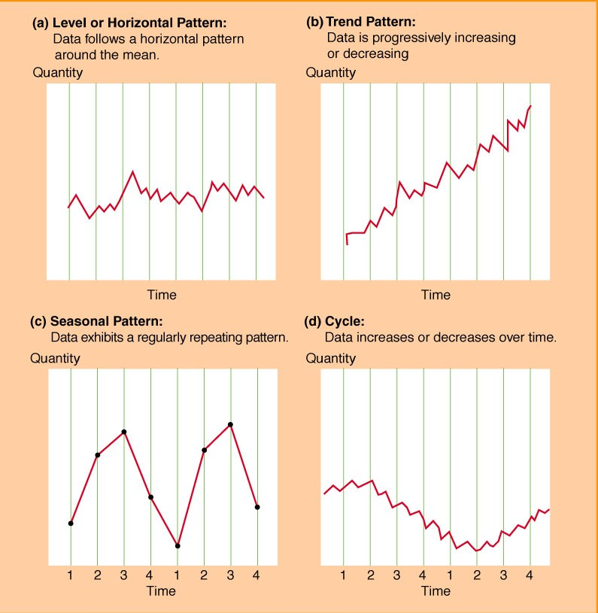
Components of an Observation
Observed demand (O) =
Systematic component (S) + Random component (R)
Level (current deseasonalized demand)
Trend (growth or decline in demand)
Seasonality (predictable seasonal fluctuation)
Systematic component: Expected value of demand
Random component: The part of the forecast that deviates from the systematic component
Forecast error: difference between forecast and actual demand

Slide 11
Systematic Component
Three models for systematic component:
Additive
S = level + trend + seasonal factor
Multiplicative
S = level x trend x seasonal factor
Mixed
S = (level + trend) x seasonal factor

Slide 12
Static vs. Adaptive Methods
Static methods:
Estimates of level, trend, seasonality do not vary as new demand is observed
Estimate based on historical data
Then use forever…
Adaptive methods:
Update estimates of level, trend, seasonality as new demand is observed

Slide 13
Static Methods
Assume a mixed model:
Systematic component = (level + trend)(seasonal factor)
F_{t+l} = [L + (t + l)T]S_{t+l}
= forecast in period t for demand in period t + l
L = estimate of level for period 0
T = estimate of trend for period 0
S_{t} = estimate of seasonal factor for period t
F_{t} = forecast of demand in period t

Slide 14
Estimating Level and Trend
Before estimating level and trend, demand data must be deseasonalized
Deseasonalized demand = demand that would have been observed in the absence of seasonal fluctuations
Periodicity (p)
the number of periods after which the seasonal cycle repeats itself
for demand at Tahoe Salt : p = 4

Slide 15
Tahoe Salt
Year | Quarter | Period, t | Demand, D_{t}
1 | 2 | 1 | 8,000
1 | 3 | 2 | 13,000
1 | 4 | 3 | 23,000
2 | 1 | 4 | 34,000
2 | 2 | 5 | 10,000
2 | 3 | 6 | 18,000
2 | 4 | 7 | 23,000
3 | 1 | 8 | 38,000
3 | 2 | 9 | 12,000
3 | 3 | 10 | 13,000
3 | 4 | 11 | 32,000
4 | 1 | 12 | 41,000
Table 7-1

Slide 16
Deseasonalizing Demand
So, average demand in periods gives deseasonalized demand for period
If p is odd, period l + (p + 1)/2 exists
If p is even:
Calculate average for periods
Calculate average for periods
Average the two

Slide 17
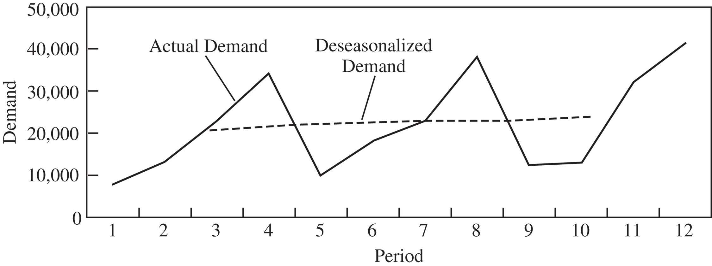
Deseasonalizing Demand

Slide 18
Deseasonalizing Demand

Slide 19
Deseasonalizing Demand
For the example, p = 4 is even
For t = 3:
= {8000+10000+[(2)(13000)+(2)(23000)+(2)(34000)]} / 8
= 19750
= {13000+18000+[(2)(23000)+(2)(34000)+(2)(10000)] / 8
= 20625

Slide 20
Deseasonalized Demand

Slide 21
Deseasonalizing Demand
Then include trend
where D_{t} = deseasonalized demand in period t
L = level (deseasonalized demand at period 0)
T = trend (rate of growth of deseasonalized demand)
Trend is determined by linear regression using deseasonalized demand as the dependent variable and period as the independent variable (can be done in Excel)
In the example, L = 18,439 and T = 524

Slide 22
Different Example…MP3 Players

Slide 23
Different Example…MP3 Players
Perform a regression on the data
The intercept value is assumed to be starting level of the process
Estimated slope from regression assumed to be initial slope in process
Use EXCEL
Tools Data Analysis Regression

Slide 24
MP3 Players: Demand=a+b(Period)
Number of data points
a = 104.02
b= 5.59
F₁₃ = 104.02 + 5.59(13) = 176.77

Slide 25
Adequacy of Regression
R²
Value of R²
The ratio is a measure of the goodness of the fit in the regression
SSE is the total squared error in the regression -- if low, R² is high.
Want R² > .95

Slide 26
Estimating Seasonal Factors
Calculate deseasonalized demand
for each period
S_{t} = D_{t} / D_{t} = seasonal factor for period t
In the example, L = 18,439 and T = 524
In the example,
D₂ = 18439 + (524)(2) = 19487 D₂ = 13000
S₂ = 13000/19487 = 0.67
The seasonal factors for the other periods are calculated in the same manner

Slide 27
Estimating Seasonal Factors

Slide 28
Estimating Seasonal Factors
The overall seasonal factor for a “season” is then obtained by averaging all of the factors for a “season”
If there are r seasonal cycles, for all periods of the form jp+i, 1<i<p, the seasonal factor for season i is
In the example, there are 3 seasonal cycles in the data and p=4, so
S₁ = (0.42+0.47+0.52)/3 = 0.47
S₂ = (0.67+0.83+0.55)/3 = 0.68
S₃ = (1.15+1.04+1.32)/3 = 1.17
S₄ = (1.66+1.68+1.66)/3 = 1.67

Slide 29
Estimating the Forecast
Using the original equation, we can forecast the next four periods of demand:
F₁₃ = (L+13T)S₁ = [18439+(13)(524)](0.47) = 11868
F₁₄ = (L+14T)S₂ = [18439+(14)(524)](0.68) = 17527
F₁₅ = (L+15T)S₃ = [18439+(15)(524)](1.17) = 30770
F₁₆ = (L+16T)S₄ = [18439+(16)(524)](1.67) = 44794

Slide 30
Basic Formula for Adaptive Forecasting
Estimates of level, trend, and seasonality are adjusted after each demand observation
F_{t+l} = (L_{t} + l T_{t} )S_{t+l} = forecast for period t+l in period t
L_{t} = Estimate of level at the end of period t
T_{t} = Estimate of trend at the end of period t
S_{t} = Estimate of seasonal factor for period t
F_{t} = Forecast of demand for period t (made period t-1 or earlier)
D_{t} = Actual demand observed in period t
E_{t} = Forecast error in period t

Slide 31
General Steps in Adaptive Forecasting
Initialize: Compute initial estimates of level (L₀), trend (T₀), and seasonal factors (S₁,…,S_{p}). This is done as in static forecasting.
Forecast: Forecast demand for period t+1 using the general equation
Estimate error: Compute error E_{t+1} = F_{t+1}- D_{t+1}
Modify estimates: Modify the estimates of level (L_{t+1}), trend (T_{t+1}), and seasonal factor (S_{t+p+1}), given the error E_{t+1} in the forecast
Repeat steps 2, 3, and 4 for each subsequent period

Slide 32
Mean Squared Error (MSE)
Forecast error = E_{t} = F_{t} - D_{t}
Related to variance of forecast error:
Var(X) = E(X ²) – E(X)²
If forecasts is unbiased, E(X) = 0
Penalizes large errors much more than small
Appropriate for use when…
Cost of large error >> cost of small error

Slide 33
Mean Absolute Deviation (MAD)
Absolute deviation in period t:
Mean absolute deviation (MAD):
Good measure if cost of error is proportional to magnitude of error
Better than MSE if forecast error does not have symmetric distribution

Slide 34
MAD and SD
MAD can be used to estimate SD (standard deviation) of random component of demand (or whatever parameter is being forecast):
(And usually we assume mean of random component = 0)

Slide 35
Mean Absolute Percentage Error (MAPE)
MAD gives error in same units as demand
This can be misleading:
D = 10, F = 5 => MAD = 5
D = 10,000, F = 10,010 => MAD = 10
MAPE expresses error as %:
Useful for seasonal demands

Slide 36
Moving Average
Used when demand has no observable trend or seasonality
Systematic component of demand = level
The level in period t is the average demand over the last N periods (the N-period moving average)
Current forecast for all future periods is the same and is based on the current estimate of the level
F_{t+1} = L_{t} and F_{t+n} = L_{t}
After observing the demand for period t+1, revise the estimates as follows:
F_{t+n} = L_{t+1}

Slide 37
Moving Average Example
Weekly demand of milk over past 4 weeks: D₁ = 120, D₂ = 127, D₃ = 114, D₄ = 122
Forecast for Period 5 using 4-week MA
L₄ = (D₄ + D₃ + D₂ + D₁)/4
= (122 + 114 + 127 + 120)/4 = 120.75
F₅ = L₄ = 120.75 gallons

Slide 38
Moving Average Example
Suppose Period-5 demand turns out to be 125 gallons
What is forecast error? What is estimate for Period 6?
E₅ = F₅ – D₅ = 125 – 120.75 = 4.25
L₆ = (D₅ + D₄ + D₃ + D₂)/4
= (125 + 122 + 114 + 127)/4 = 122

Slide 39
Another Example: Find Forecast for periods 13 and 20 using MA.
N=3
N=5
Which is better?

Slide 40
Choice of N
Small N
Reacts to changes faster
May be better for “changing”process
Higher forecast error variance
Large N
Reacts slower
Lower forecast error variance

Slide 41
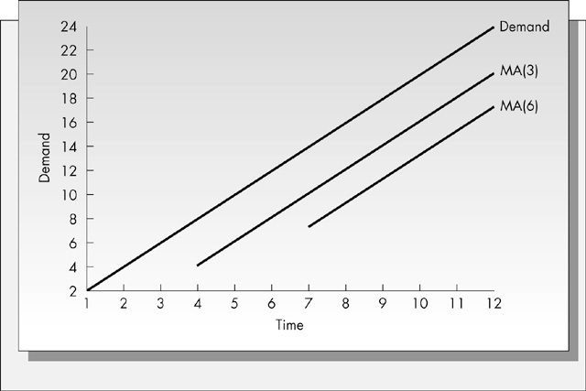
Moving Average Lags a Trend

Slide 42
Moving Average

Slide 43
Moving Average Example
From Tahoe Salt example
At the end of period 4, what is the forecast demand for periods 5 through 8 using a 4-period moving average?
L₄ = (D₄+D₃+D₂+D₁)/4 = (34000+23000+13000+8000)/4 = 19500
F₅ = 19500 = F₆ = F₇ = F₈
Observe demand in period 5 to be D₅ = 10000
Forecast error in period 5, E₅ = F₅ - D₅ = 19500 - 10000 = 9500
Revise estimate of level in period 5:
L₅ = (D₅+D₄+D₃+D₂)/4 = (10000+34000+23000+13000)/4 = 20000
F₆ = L₅ = 20000

Slide 44
Simple Exponential Smoothing
Used when demand has no observable trend or seasonality
Systematic component of demand = level
Initial estimate of level, L₀, assumed to be the average of all historical data
Current forecast for all future periods is equal to the current estimate of the level and is given as follows:
F_{t+1} = L_{t} and F_{t+n} = L_{t}
After observing demand D_{t+1}, revise the estimate of the level:
L_{t+1} = αD_{t+1} + (1-α)L_{t}

Slide 45
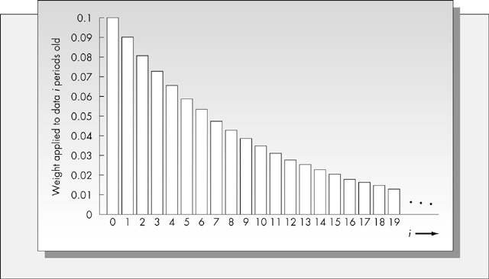
Weights in Exponential Smoothing

Slide 46
Simple Exponential Smoothing
Supermarket data for milk :
E₁ = F₁ – D₁ = 120.75 –120 = 0.75

Slide 47
Simple Exponential Smoothing Example
From Tahoe Salt data, forecast demand for period 1 using exponential smoothing
L₀ = average of all 12 periods of data
= Σ_{(i=1 to 12)}[D_{i}]/12 = 22083
F₁ = L₀ = 22083
Observed demand for period 1 = D₁ = 8000
Forecast error for period 1, E₁, is as follows:
E₁ = F₁ - D₁ = 22083 - 8000 = 14083
Assuming α = 0.1, revised estimate of level for period 1:
L₁ = αD₁ + (1-α)L₀ = (0.1)(8000) + (0.9)(22083) = 20675
F₂ = L₁ = 20675
Note that the estimate of level for period 1 is lower than in period 0

Slide 48
Exponential Smoothing Example
Per Month Dem Fcst (α =0.3) Fcst (α =0.5)
1 Jan 37 - -
2 Feb 40 37.00 37.00
3 Mar 41 37.90 38.50
4 Apr 37 38.83 39.75
5 May 45 38.28 38.37
6 Jun 50 40.29 41.68
7 Jul 43 43.20 45.84
8 Aug 47 43.14 44.42
9 Sep 56 44.30 45.71
10 Oct 52 47.81 50.85
11 Nov 55 49.06 51.42
12 Dec 54 50.84 53.21
13 Jan - 51.79 53.61
L₂ = αD₂ + (1 - α)L₁
= (0.30)(40) + (0.70)(37)
= 37.9
L₃ = αD₃ + (1 - α)L₂
= (0.30)(41) + (0.70)(37.9)
= 38.83
L₁₂ = αD₁₂ + (1 - α)L₁₁
= (0.30)(54) + (0.70)(50.84)
= 51.79

Slide 49
Exponential Smoothing

Slide 50
Holt’s Method (or Double ES, Trend-Corrected ES)
Used for demands with trend but no seasonality
Forecast:
Estimates of level and trend:
current obs. of level at end of t
previous est. of level at end of t
current obs. of trend at end of t
previous est. of trend at end of t

Slide 51
Holt’s Method: Example
MP3 players: initial demand history is used to find initial level and trend
Using regression analysis
L₀ = 7,367 and T₀ = 673
Forecast for Period 1 = ?
(α = 0.1, β = 0.2)
F₁ = L₀ + T₀ = 7,367 + 673 = 8,040
L₀

Slide 52
Trend-Corrected Exponential Smoothing (Holt’s Model)
Suppose D₁ = 8,415
Revised estimate
L₁ = αD₁ + (1 – α)(L₀ + T₀)
= 0.1 x 8,415 + 0.9 x 8,040 = 8,078
T₁ = β(L₁ – L₀) + (1 – β)T₀
= 0.2 x (8,078 – 7,367) + 0.8 x 673 = 681
With new L₁ + T₁
F₂ = L₁ + T₁ = 8,078 + 681 = 8,759
Calculate F₁₄:
F₁₄ = L₁ + 13T₁ = 8,078 + 13 x 681 = 16,931

Slide 53
Trend-Corrected Exponential Smoothing (Holt’s Model)
In general, after observing demand for period t+1, revise the estimates for level and trend as follows:
L_{t+1} = αD_{t+1} + (1-α)(L_{t} + T_{t})
T_{t+1} = β(L_{t+1} - L_{t}) + (1-β)T_{t}
α = smoothing constant for level
β = smoothing constant for trend
Example: Tahoe Salt demand data.
Forecast demand for period 1 using Holt’s model (trend corrected exponential smoothing)
Using linear regression,
L₀ = 12015 (linear intercept at end of data set)
T₀ = 1549 (linear slope)

Slide 54
Holt’s Model Example (continued)
Forecast for period 1:
F₁ = L₀ + T₀ = 12015 + 1549 = 13564
Observed demand for period 1 = D1 = 8000
E₁ = F₁ - D₁ = 13564 - 8000 = 5564
Assume α = 0.1, β = 0.2
L₁ = αD₁+(1-α)(L₀+T₀)=(0.1)(8000)+(0.9)(13564) =13008
T₁ = β(L₁- L₀)+(1-β)T₀ = (0.2)(13008-12015) +(0.8)(1549)=1438
F₂ = L₁ + T₁ = 13008 + 1438 = 14446
F₅ = L₁ + 4T₁ = 13008 + (4)(1438) = 18760

Slide 55
Example
Slope and intercept
terms from regression

Slide 56
Example : Varying Smoothing Constants

Slide 57
Example : Varying Smoothing Constants

Slide 58
Example : Varying Smoothing Constants

Slide 59
Trend- and Seasonality-Corrected Exponential Smoothing (Winters)
Appropriate when the systematic component of demand is assumed to have a level, trend, and seasonal factor
Systematic component = (level+trend)(seasonal factor)
Assume periodicity p
Obtain initial estimates of level (L₀), trend (T₀), seasonal factors (S₁,…,S_{p}) using procedure for static forecasting
In period t, the forecast for future periods is given by:
F_{t+1} = (L_{t}+T_{t})(S_{t+1}) and F_{t+n} = (L_{t} + nT_{t})S_{t+n}

Slide 60
Winter’s Method
After observing demand for period t, revise estimates for level, trend, and seasonal factors as follows:
current obs. of level at end of t
previous est. of level at end of t
current obs. of trend at end of t
previous est. of trend at end of t
current obs. of seas. factor for t
previous est. of seas. factor for t

Slide 61
Updating Equations
Once a new data point is observed update the equations for L, T and S
If the seasonal factors don’t sum to N then re-normalize the seasonal factors
Recall: Systematic component = (level+trend)(seasonal factor)
Update the values in the forecasting equation so as to revise the forecast for the next, and subsequent periods

Slide 62
Winter’s Method: Example
Back to Tahoe Salt
Initial estimates (from static method example):
L₀ = 18,439 T₀ = 524
S₋₃= 0.47, S₋₂ = 0.68, S₋₁ = 1.17, S₀ = 1.67 (renumbered)
Calculate F₁:
F₁ = (L₀ + T₀)S₋₃ = (18,439 + 524)(0.47) = 8,913

Slide 63
Winter’s Method: Example
L₀ = 18,439 T₀ = 524
S₋₃= 0.47, S₋₂ = 0.68, S₋₁ = 1.17, S₀ = 1.67
D₁ = 8000, α = 0.1, β = 0.2, γ = 0.1
L₁ = α D₁/S₋₃ + (1 – α)(L₀ + T₀)
= 0.1 x (8,000/0.47) + 0.9 x (18,439 + 524) = 18,769
T₁ = β(L₁ – L₀) + (1 – β)T₀
= 0.2 x (18,769 – 18,439) + 0.8 x 524 = 485
S₁ = γ D₁/L₁ + (1 – γ)S₋₃
= 0.1 x (8,000/18,769) + 0.9 x 0.47 = 0.47
F₂ = (L₁ + T₁)S₋₂ = (18,769 + 485)0.68 = 13,093

Slide 64
Regression Analysis
Allows us to explicitly deal with seasonality
Function: x = b sin ω(t+θ)
b = amplitude
t+θ = origin (0) + offset
ω = length of sin wave
= 2(π)/12 for 12-period season

Slide 65
Regression for Seasonality
Recall:
x = b sin ω(t+θ)
= b₁ sin ωt + b₂ cos ωt
Thus, if we want to use a model for a 12-period season where there is a symmetric pattern:
D_{t}=b₁ + b₂ sin (2π/12)t + b₃ cos (2π/12)t + ε_{t}

Slide 66
Model Adaptations
What if there was a trend component?
Add a trend term: b₄t
What if there was a growth or shrinkage with the seasonal amplitude?
Rewrite: b₂ sin ωt
as: (b₁ + b₂t)sin ωt

Slide 67
Snow Tires Example: Regression Analysis
D_{t}=191.8 + 77.2 sin (2π/12)t - 14.6 cos (2π/12)t +2.45t

Slide 68
Bias
Measures whether errors tend to be high or low
If errors are random, unbiased, then bias_{n} ≈ 0
If error is unbiased, plot of error over time should cluster around E = 0 line
Useful for detecting new trends (e.g., auto demand drop in 2008-9)
Or new inaccuracy in forecast method

Slide 69
Tracking Signal
Bias, too, uses same units as demand
Again, useful to express as ratio
Typically, divide by MAD (not demands)
…called tracking signal:
Usually conclude something’s wrong if TS is outside range ±6

Slide 70
Declining Alpha
Suppose demand increases or decreases suddenly
New level
But not a trend: Holt’s method doesn’t apply
Want α to start large and get smaller
Give more weight to recent data
And then revert to ES as usual
Aim for α = 1 − ρ; set α₀ = 1 and

Slide 71
Selecting the Best Smoothing Constant
Generally keep constants <0.2
Choose constant that minimizes error measure
MSE, MAD, or MAPE
If don’t know which of these to use, use MSE
Can use Solver for this purpose
Update error measure over time and re-evaluate smoothing constants

Slide 72
Selecting the Best Smoothing Constant
Figure 7-5

Slide 73
Forecasting Demand at Tahoe Salt
Moving average
Simple exponential smoothing
Trend-corrected exponential smoothing
Trend- and seasonality-corrected exponential smoothing

Slide 74
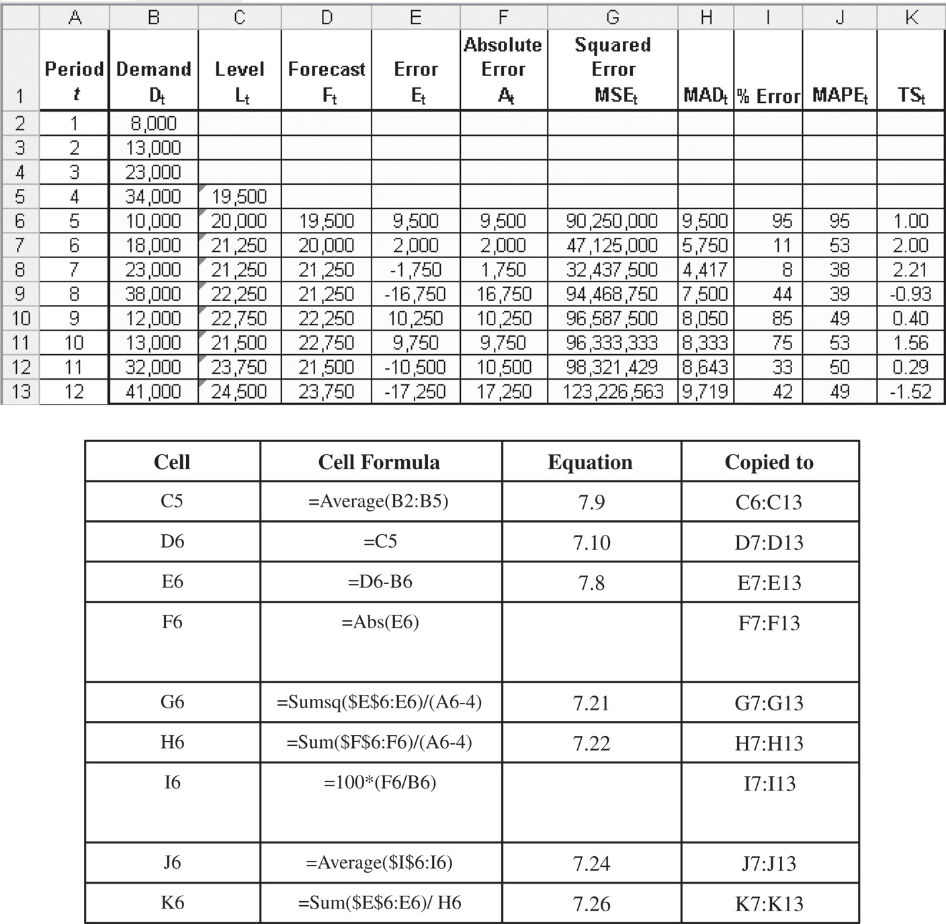
Forecasting Demand at Tahoe Salt
Moving average
Figure 7-7

Slide 75
Forecasting Demand at Tahoe Salt
Moving average
L₁₂ = 24,500
F₁₃ = F₁₄ = F₁₅ = F₁₆ = L₁₂ = 24,500
σ = 1.25 x 9,719 = 12,148

Slide 76
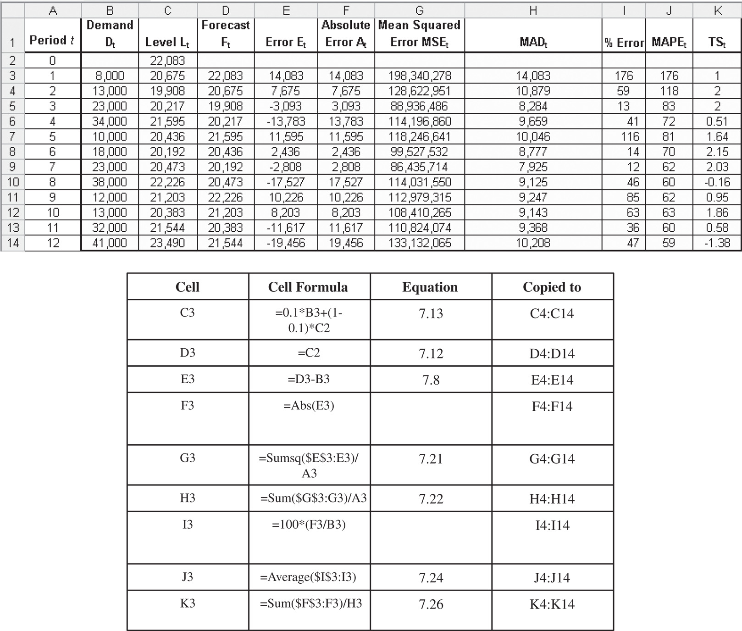
Forecasting Demand at Tahoe Salt
exponential smoothing
Figure 7-8

Slide 77
Forecasting Demand at Tahoe Salt
Single exponential smoothing
L₀ = 22,083
L₁₂ = 23,490
F₁₃ = F₁₄ = F₁₅ = F₁₆ = L₁₂ = 23,490
σ = 1.25 x 10,208 = 12,761

Slide 78
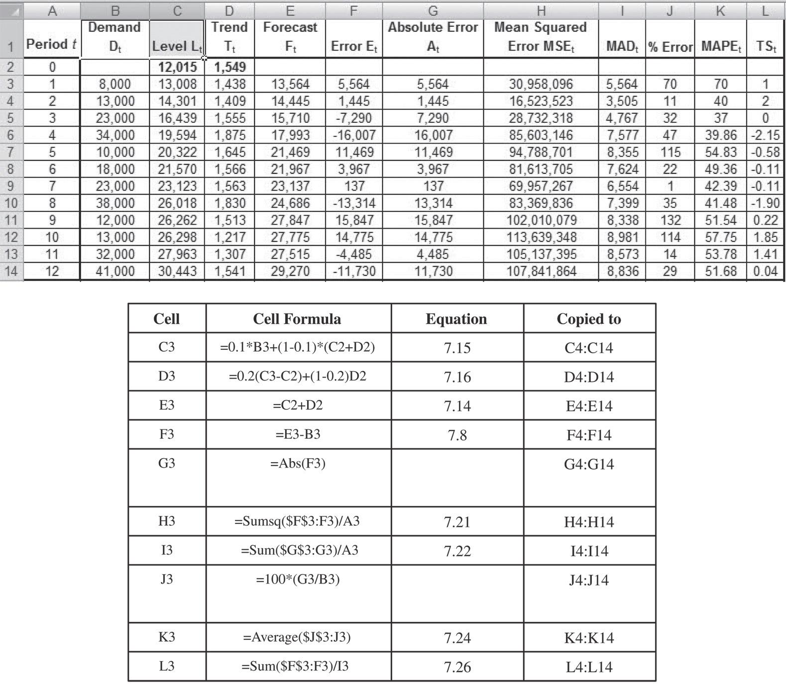
Forecasting Demand at Tahoe Salt
Trend-Corrected Exponential Smoothing
Figure 7-9

Slide 79
Forecasting Demand at Tahoe Salt
Trend-Corrected Exponential Smoothing
L₀ = 12,015 and T₀ = 1,549
L₁₂ = 30,443 and T₁₂ = 1,541
F₁₃ = L₁₂ + T₁₂ = 30,443 + 1,541 = 31,984
F₁₄ = L₁₂ + 2T₁₂ = 30,443 + 2 x 1,541 = 33,525
F₁₅ = L₁₂ + 3T₁₂ = 30,443 + 3 x 1,541 = 35,066
F₁₆ = L₁₂ + 4T₁₂ = 30,443 + 4 x 1,541 = 36,607
σ = 1.25 x 8,836 = 11,045

Slide 80
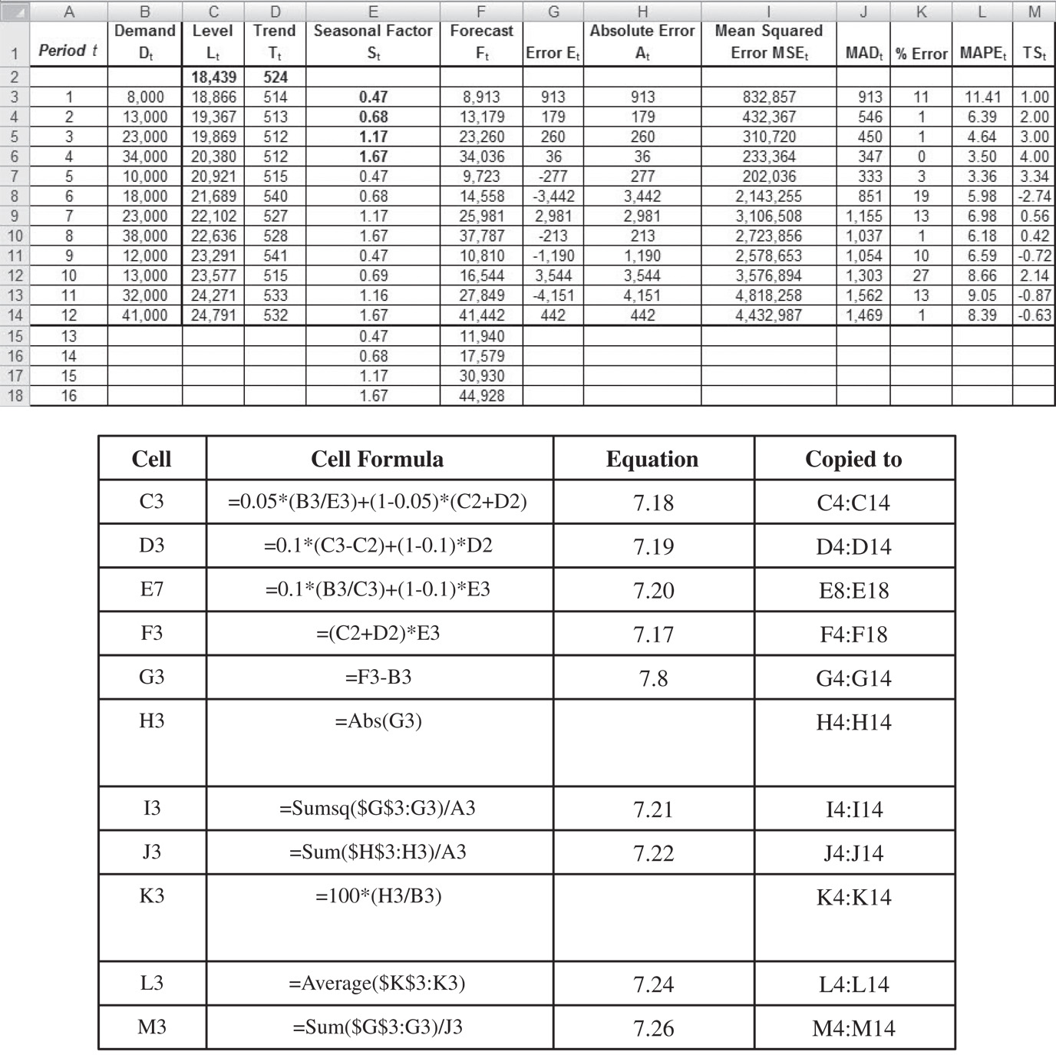
Forecasting Demand at Tahoe Salt
Trend- and Seasonality-Corrected
Figure 7-10

Slide 81
Forecasting Demand at Tahoe Salt
Trend- and Seasonality-Corrected
L₀ = 18,439 T₀ =524
S₁ = 0.47 S₂ = 0.68 S₃ = 1.17 S₄ = 1.67
L₁₂ = 24,791 T₁₂ = 532
F₁₃ = (L₁₂ + T₁₂)S₁₃ = (24,791 + 532)0.47 = 11,940
F₁₄ = (L₁₂ + 2T₁₂)S₁₃ = (24,791 + 2 x 532)0.68 = 17,579
F₁₅ = (L₁₂ + 3T₁₂)S₁₃ = (24,791 + 3 x 532)1.17 = 30,930
F₁₆ = (L₁₂ + 4T₁₂)S₁₃ = (24,791 + 4 x 532)1.67 = 44,928
σ = 1.25 x 1,469 = 1,836

Slide 82
Forecasting Demand at Tahoe Salt
Forecasting Method | MAD | MAPE (%) | TS Range
Four-period moving average | 9,719 | 49 | –1.52 to 2.21
Simple exponential smoothing | 10,208 | 59 | –1.38 to 2.15
Holt’s model | 8,836 | 52 | –2.15 to 2.00
Winter’s model | 1,469 | 8 | –2.74 to 4.00
Table 7-2

Slide 83
Forecasting in Practice
Collaborate in building forecasts
The value of data depends on where you are in the supply chain
Be sure to distinguish between demand and sales
Tracking signals may be useful for indicating forecast bias.
Box-Jenkins methods require substantial data history, use the correlation structure of the data, and can provide significantly improved forecasts under some circumstances.
Overly sophisticated forecasting methods can be problematic, especially for long term forecasting. (Refer to Figure on the next slide.)

Slide 84
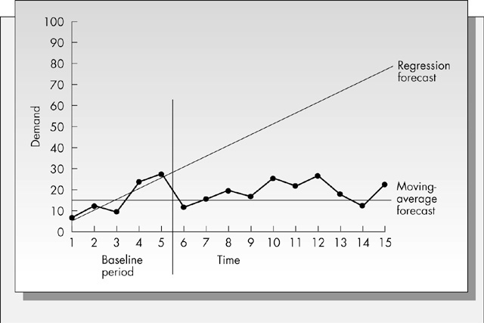
The Difficulty with Long-Term Forecasts

